Slide 1
How you Pass IELTS Writing!

Slide 2
Imagine being confident you can get that 7 or 8 you need when you walk into the test room

Slide 3
Practice your Writing
Improve your writing fluency
Optimise your time management
Troubleshoot areas of weakness

Slide 5
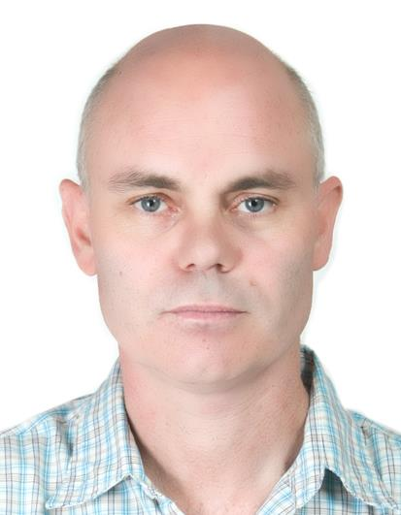
Why Mike!
Trained IELTS examiner
Expert writing tutor
Learn exactly what to do
Save time
Save money
Money back guarantee

Slide 6
Examiner’s Feedback
Scores for the four criteria
Discover mistakes
Tips to improve
Resources to help you
Model answer band 9

Slide 7
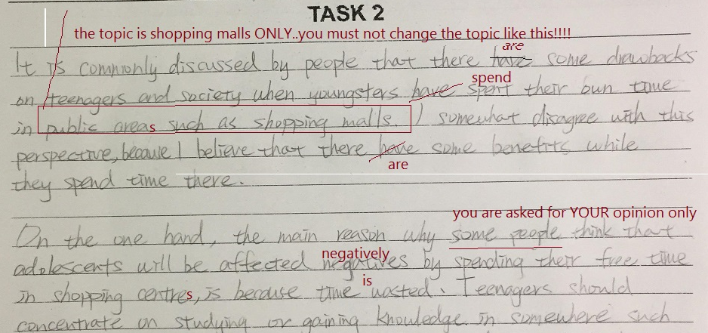

Slide 8
Task Response = 6
You must not change the topic from shopping malls to public areas, see my advice on analysing questions: http://www.ieltsanswers.com/task-analysis.html

Slide 9
Ask questions about the feedback
Clarify my feedback
Check you understand
Fix problems

Slide 10
Apply new knowledge
Learn from past mistakes
Decrease errors
Increase your score

Slide 11
How to do it
Make payment
Receive a list of questions
Choose one of my questions or your own
Handwrite your answer or type it
E-mail it to me
Receive a response within 24 hours
Ask questions about my feedback
Write your next task
http://www.ieltsanswers.com/writing-correction-ielts.html

Slide 12
Pass your test!

